Slide 1

IOT ARCHITECTURE & Reference Model
Lecture – 4
Eng. PN Karunanayake

Slide 2
State of the art
IoT architecture varies from solution to solution.
IoT as a technology consists of four main components, over which an architecture is framed.
1) Sensors
2) Devices
3) Gateway
4) Cloud

Slide 3
Stages of IoT Architecture

Slide 4
Stage 1:- Sensors/actuators
Sensors collect data from the environment or object under measurement and turn it into useful data. Ex:- Your cell phone
Actuators can also intervene to change the physical conditions that generate the data. An actuator might, for example, shut off a power supply, adjust an air flow valve, or move a robotic gripper in an assembly process.
Also robotic camera systems, water level detectors, air quality sensors, accelerometers, and heart rate monitors can be connected.
The scope of the IoT is expanding rapidly, due to low-power wireless sensor network technologies and Power over Ethernet, which enable devices on a wired LAN to operate without the need for an A/C power source.

Slide 5
Stage 2:- The Internet gateway
Stage 2 systems often sit close to the sensors and actuators.
The data from the sensors starts in analog form and it needs to be aggregated and converted into digital streams for further processing downstream.
Data acquisition systems (DAS) perform data aggregation and conversion functions. The DAS connects to the sensor network, aggregates outputs, and performs the analog-to-digital conversion.
The Internet gateway receives the aggregated and digitized data and routes it over Wi-Fi, wired LANs, or the Internet, to Stage 3 systems for further processing.
Ex. a pump might contain a half-dozen sensors and actuators that feed data into a data aggregation device that also digitizes the data. This device might be physically attached to the pump. An adjacent gateway device or server would then process the data and forward it to the Stage 3 or Stage 4 systems.
Intelligent gateways can build on additional, basic gateway functionality by adding such capabilities as analytics, malware protection, and data management services. These systems enable the analysis of data streams in real time.

Slide 6
Stage 3:- Edge IT
Once data has been digitized and aggregated, data may require further processing before it enters the data centre. This is where edge IT systems, which perform further analysis.
Edge IT processing systems may be located in remote offices or other edge locations. In general, these sit in the facility or location where the sensors reside closer to the sensors, such as in a wiring closet.
Since IoT data may require higher network bandwidth, it's best to have systems at the edge capable of performing analytics as a way to lessen the burden on core IT infrastructure. The security concerns, storage issues, and delays in processing the data might become a major issue. With a staged approach, data can be pre-processed and passed to the next stage.
For example, rather than passing on raw vibration data for the pumps, you could aggregate and convert the data, analyse it, and send only projections as to when each device will fail or need service.

Slide 7
Stage 4:-The data centre and cloud
Data that needs more in-depth processing, and where feedback doesn't have to be immediate, gets forwarded to physical data centre or cloud-based systems, where more powerful IT systems can analyse, manage, and securely store the data.
It takes longer to get results when you wait until data reaches Stage 4, but you can execute a more in-depth analysis, as well as combine your sensor data with data from other sources for deeper insights.
Stage 4 processing may take place on-premises, in the cloud, or in a hybrid cloud system, but the type of processing executed in this stage remains the same, regardless of the platform.

Slide 9
Level 1: Physical Devices and Controllers

Slide 10
Level 1: Physical Devices and Controllers
The IoT Reference Model starts with Level 1: physical devices and controllers that might control multiple devices. These are the ―things in the IoT, and they include a wide range of endpoint devices that send and receive information.
Devices are diverse, and there are no rules about size, location, form factor, or origin. Some devices will be the size of a silicon chip. Some will be as large as vehicles.
The IoT must support the entire range. Dozens or hundreds of equipment manufacturers will produce IoT devices. To simplify compatibility and support manufacturability, the IoT Reference Model generally describes the level of processing needed from Level 1 devices.

Slide 11
Level 2: Connectivity

Slide 12
Level 3: Edge (fog) computing

Slide 13
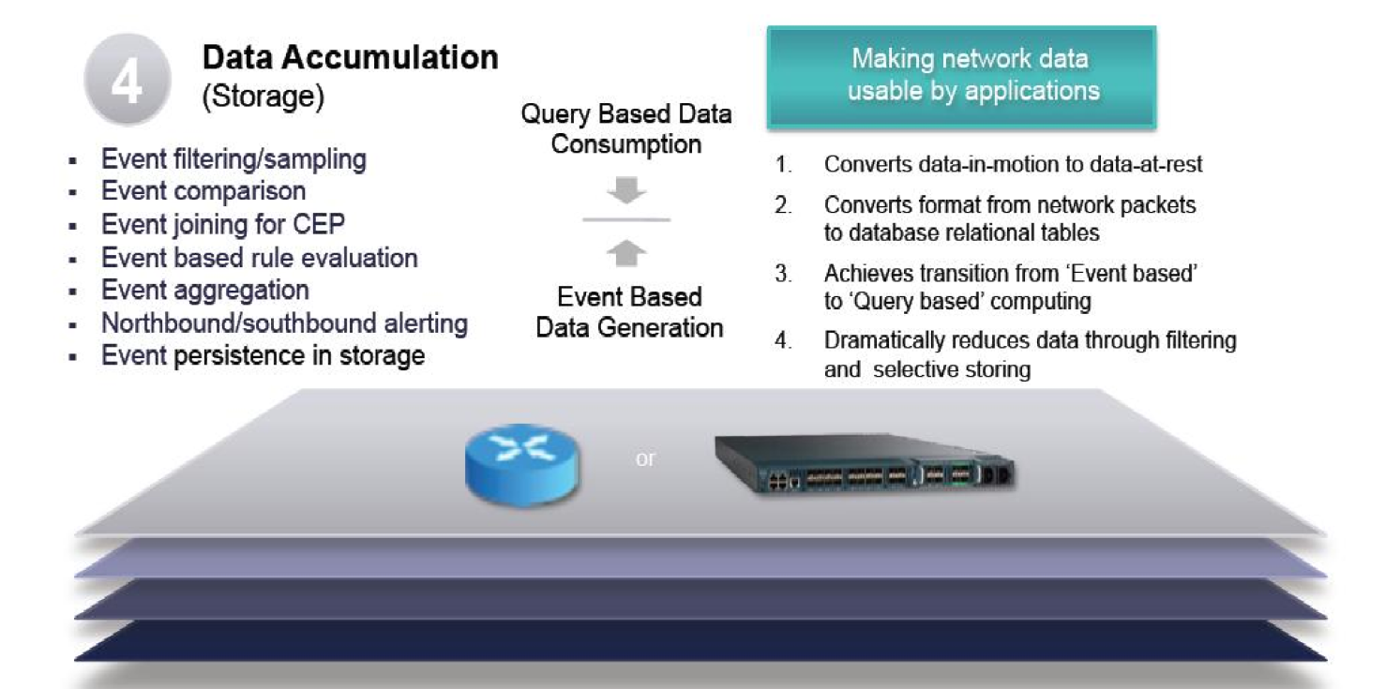
Level 4: Data accumulation

Slide 14
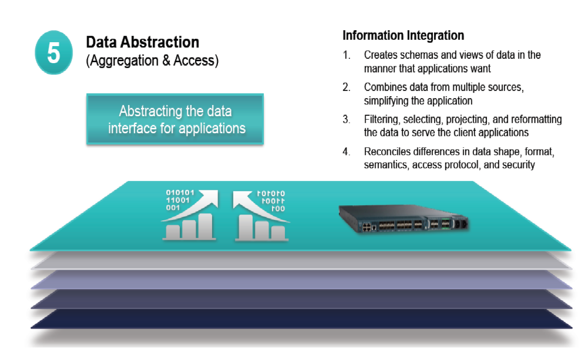
Level 5: Data abstraction

Slide 15
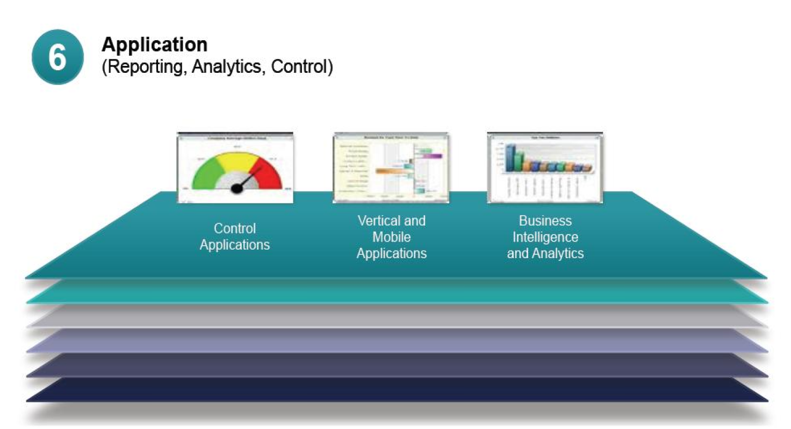
Level 6: Application

Slide 16
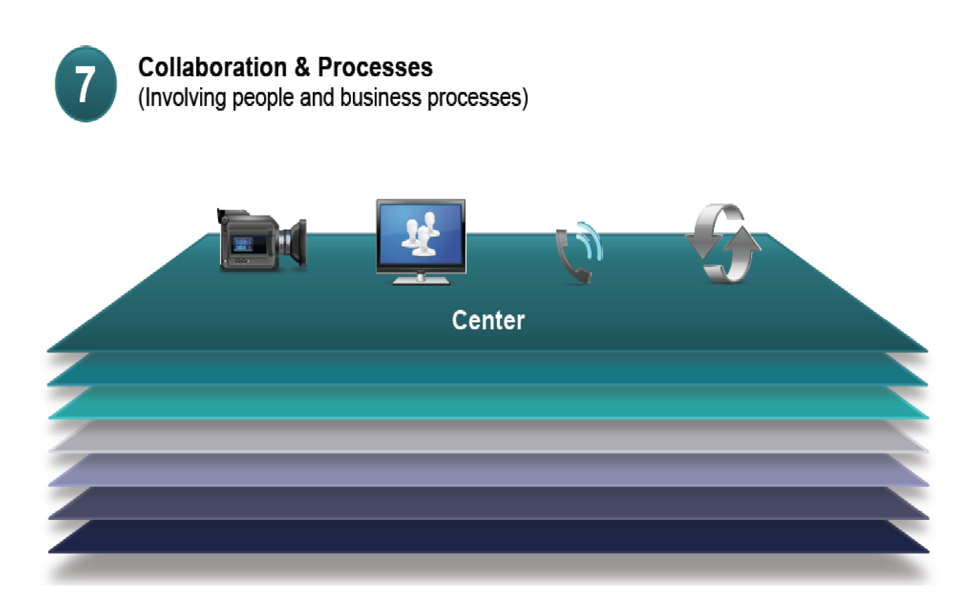
Level 7: Collaboration & Processes

Slide 17
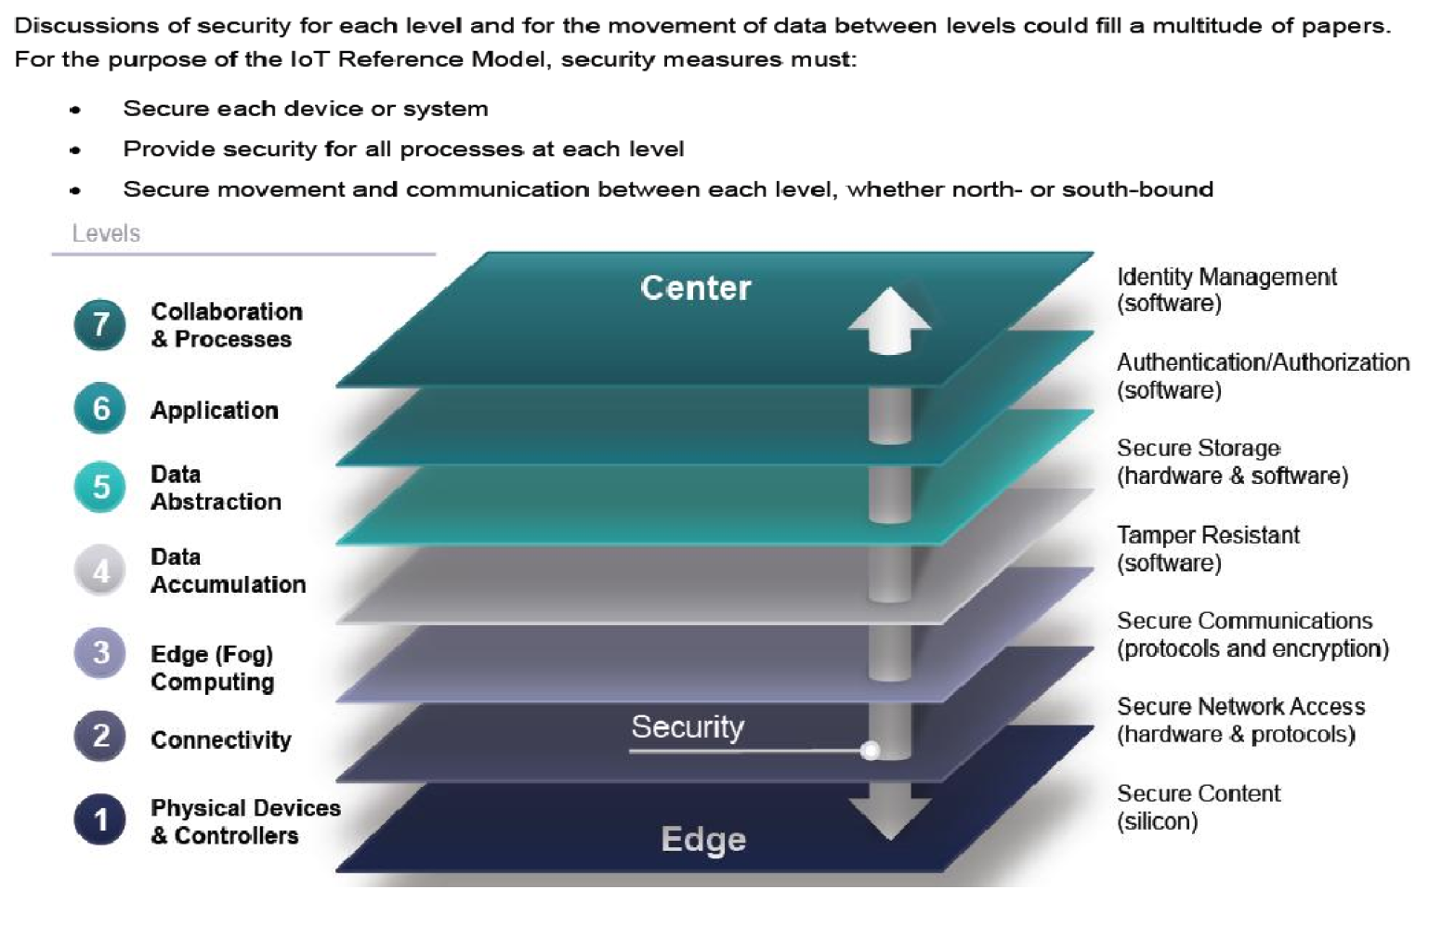
Security in the Iot

